Slide 1
ADVERSARIAL ATTACK AGAINST NEURAL NETWORKS
Rohan Pradhan | Nirmal Kanagasabai

Slide 2
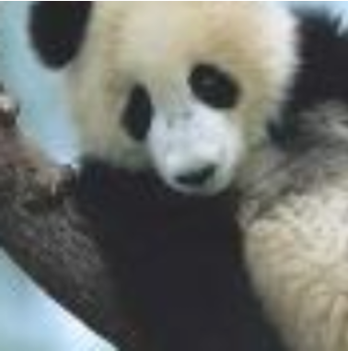
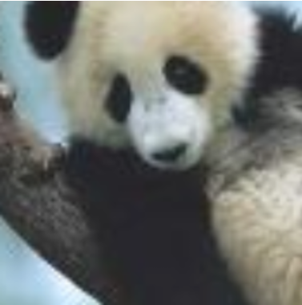
QUICK TEST ON IMAGE CLASSIFICATION
What are the differences between these two images?
What would you classify both these images as?
How confident are you in your classification?

Slide 3
RESULT
PANDA Confidence: 57.7%
GIBBON Confidence: 99.3%

Slide 4
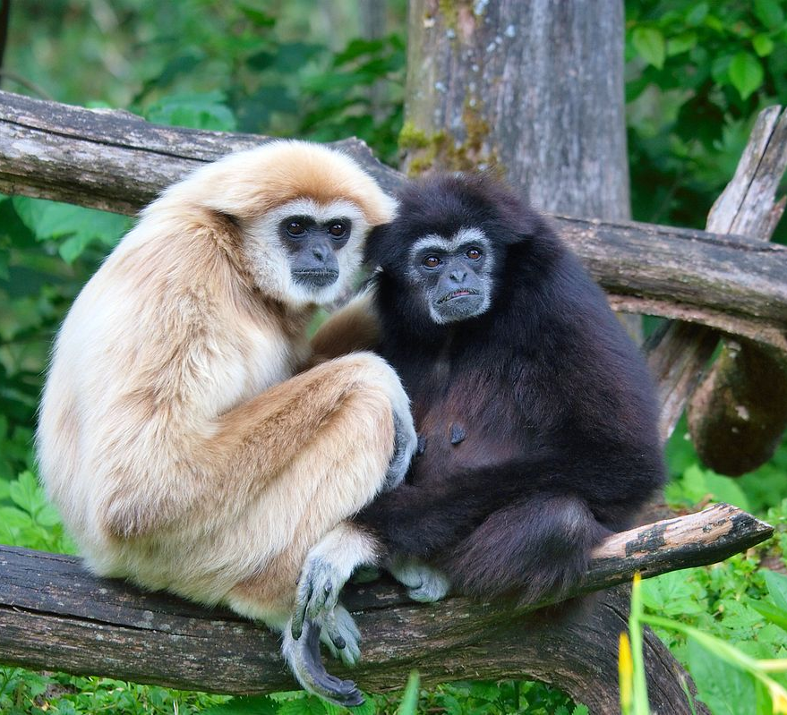
HOW AN ACTUAL GIBBON LOOKS LIKE…

Slide 5
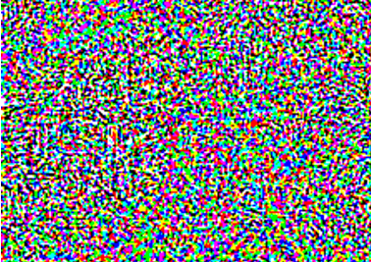
SO, WHAT WENT WRONG?
Input Data
Perturbation (Minor Modification)
Adversarial Example

Slide 6
ADVERSARIAL EXAMPLE
Input Data
Minor Modification
Adversarial Example
Intended to cause Machine Learning to misclassify it
The differences cannot be seen by the naked eye
The minor modification (perturbation) only affect 32-bit floating point values while the display resolution is only showing 8-bit floating point

Slide 7
DOMAIN EXAMPLES OF ADVERSARIAL ATTACK
Computer Vision Attacks:
Gradient Ascent Attack
Fast Sign Gradient Descent
Spam Filter / Spam Bayes:
Causative vs. Exploratory Attacks
Integrity vs. Availability Attacks
Targeted vs. Indiscriminate Attacks

Slide 8
EXISTING WORK AND RESEARCH
Defending against Adversarial attack is difficult
Carried out on training models with adversarial examples to prevent the effect from adversarial attack
- Limited success with this approach
Some promising results against attacks using Fast Gradient Sign Method
- Lack of results in attacks using Ensemble methods
Reject On Negative Impact (RONI) Defense
- Used in Spam Filtering

Slide 9


OUR PROPOSED EXTENSIONS
Recreate a simple attacker using the Fast Gradient Sign Method for known models
Recreate a Transfer Learning model using Transfer Learning techniques to create an attacker that can successfully attack deep learning models that we do not have prior knowledge to
Dataset: MNIST Image set

Slide 10
OUR PROPOSED TIMELINE
Create a simple image classifier using Deep Neural Networks
Test on Control set with random noise perturbations added
- Not for Fast Gradient Sign Method
- Ensure that it still performs well
Use Fast Gradient Sign Method to create targeted adversarial attacks on known models
Use transfer learning to infer Input to Output mapping to create targeted adversarial attacks on unknown (3rd party) models

Slide 11
WHAT’S DONE?
Create a simple image classifier using Deep Neural Networks
Test on Control set with random noise perturbations added
- Not for Fast Gradient Sign Method
- Ensure that it still performs well
Use Fast Gradient Sign Method to create targeted adversarial attacks on known models
Use transfer learning to infer Input to Output mapping to create targeted adversarial attacks on unknown (3rd party) models

Slide 12
PHASE 1
Digit Recognition (Multi-Class Image Classification) for the MNIST Dataset
Logistic Regression
Random Forest
K-Nearest Neighbours
Convolutional Deep Neural Network Classifier
Notes:
2 layers of convolution
A dropout layer of 25 percent
Dense layer using a relu activation function
Another dropout layer of 50 percent
Then a dense layer using a softmax activation function
Logistic Regression (Linear & Parametric) -> Representations are fixed (They do not grow)
Random Forest & KNN (Parametric) – Trees Grow. So does KNN
Easy to train. Longer to predict
Model Fitting & Training Phase (present)
KNN – Lazy Learner (Just memorizes the training data set) – Does not learn a deterministic function

Slide 13
ADDITION OF NOISE
As the original train and test images were loaded as Numpy arrays, a noise signal was introduced into them through Random sampling by numpy.random.normal (Normal “Gaussian” Distribution). The parameters include:
Mean “Centre” of the distribution
Standard Deviation “Spread or “Width” of the distribution
Size (of the dataset)

Slide 14
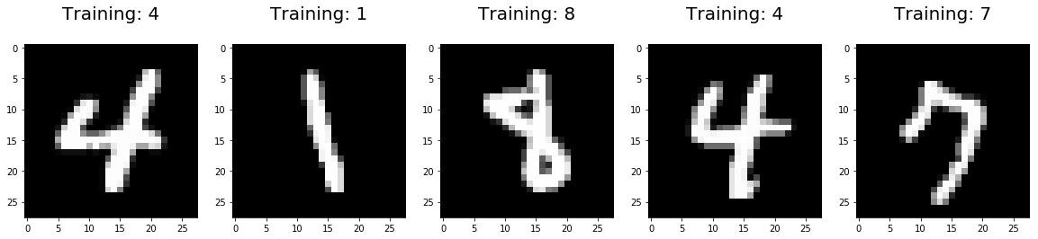
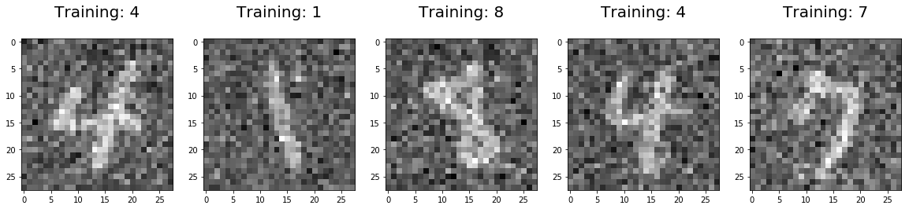
ADDITION OF NOISE
Original Image
Perturbed Image

Slide 15
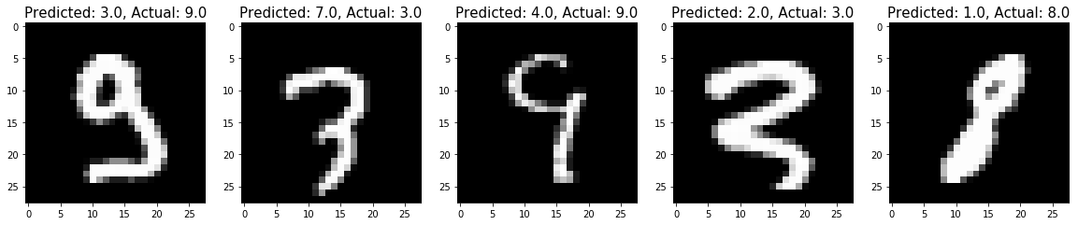
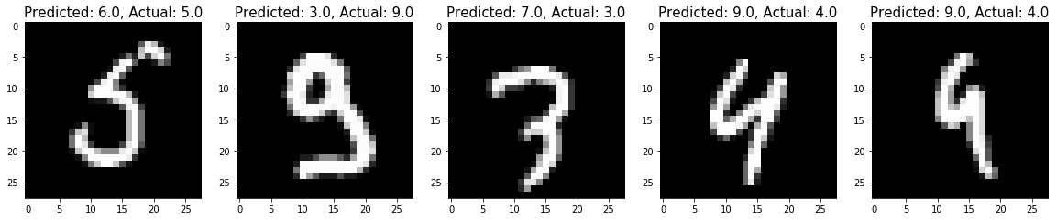
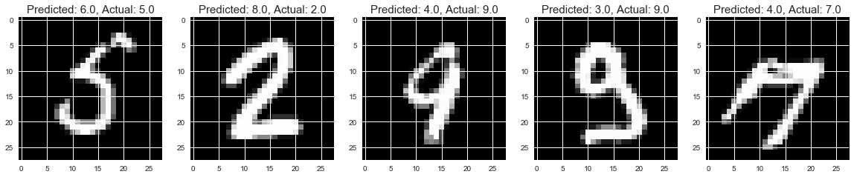
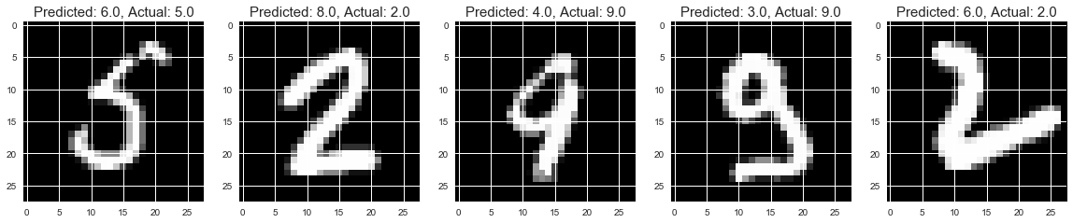
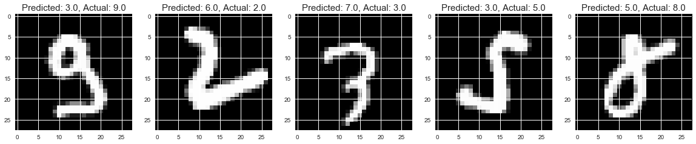
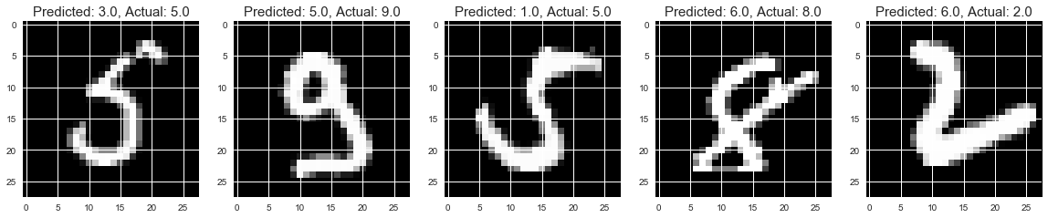
MISCLASSIFIED IMAGES
K - Nearest
Neighbours
Logistic
Regression
Random
Forest

Slide 16
ADDITION OF NOISE
Classifier | Test Type | Test Accuracy
Logistic Regression | Without Noise | 91.30%
 | With Noise | 86.78%
Random Forest | Without Noise | 94.62%
 | With Noise | 80.80%
K-Nearest Neighbors | Without Noise | 97.18%
 | With Noise | 97.01%
Deep Neural Network | Without Noise | 99.04%
 | With Noise | 99.02%
Notes:
Logisitc Regression (Discriminative Algorithm)

Slide 17
PURE SIGNAL (WITHOUT NOISE)

Slide 18
ADDITION OF RANDOM (CALCULATED) NOISE SIGNAL

Slide 19
MAXIMIZING L2 NORM IN A SPECIFIC AREA
Maximizing L2 Norm in specific area

Slide 20
MAXIMIZING L2 NORM WITHOUT FOCUSING IT ON A SPECIFIC AREA

Slide 21
WHAT NEXT?
Create a simple image classifier using Deep Neural Networks
Test on Control set with random noise perturbations added
- Not for Fast Gradient Sign Method
- Ensure that it still performs well
Use Fast Gradient Sign Method to create targeted adversarial attacks on known models
Use transfer learning to infer Input to Output mapping to create targeted adversarial attacks on unknown (3rd party) models

